Slide 1
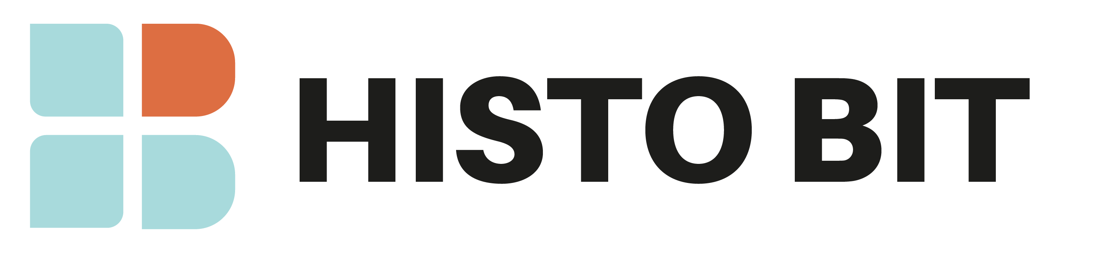
Decentralized Medical Data Ownership

Slide 2




Our Team
Paul Rodriguez
Juan Felipe Giraldo
Victor Hugo Murillo
David Flores
Developer
Developer
Frontend
UI/UX Design

Slide 3
The Problem
Fragmented patient records
Security & data breach risks
Patients lack control over access
Over-dependence on centralized systems

Slide 4
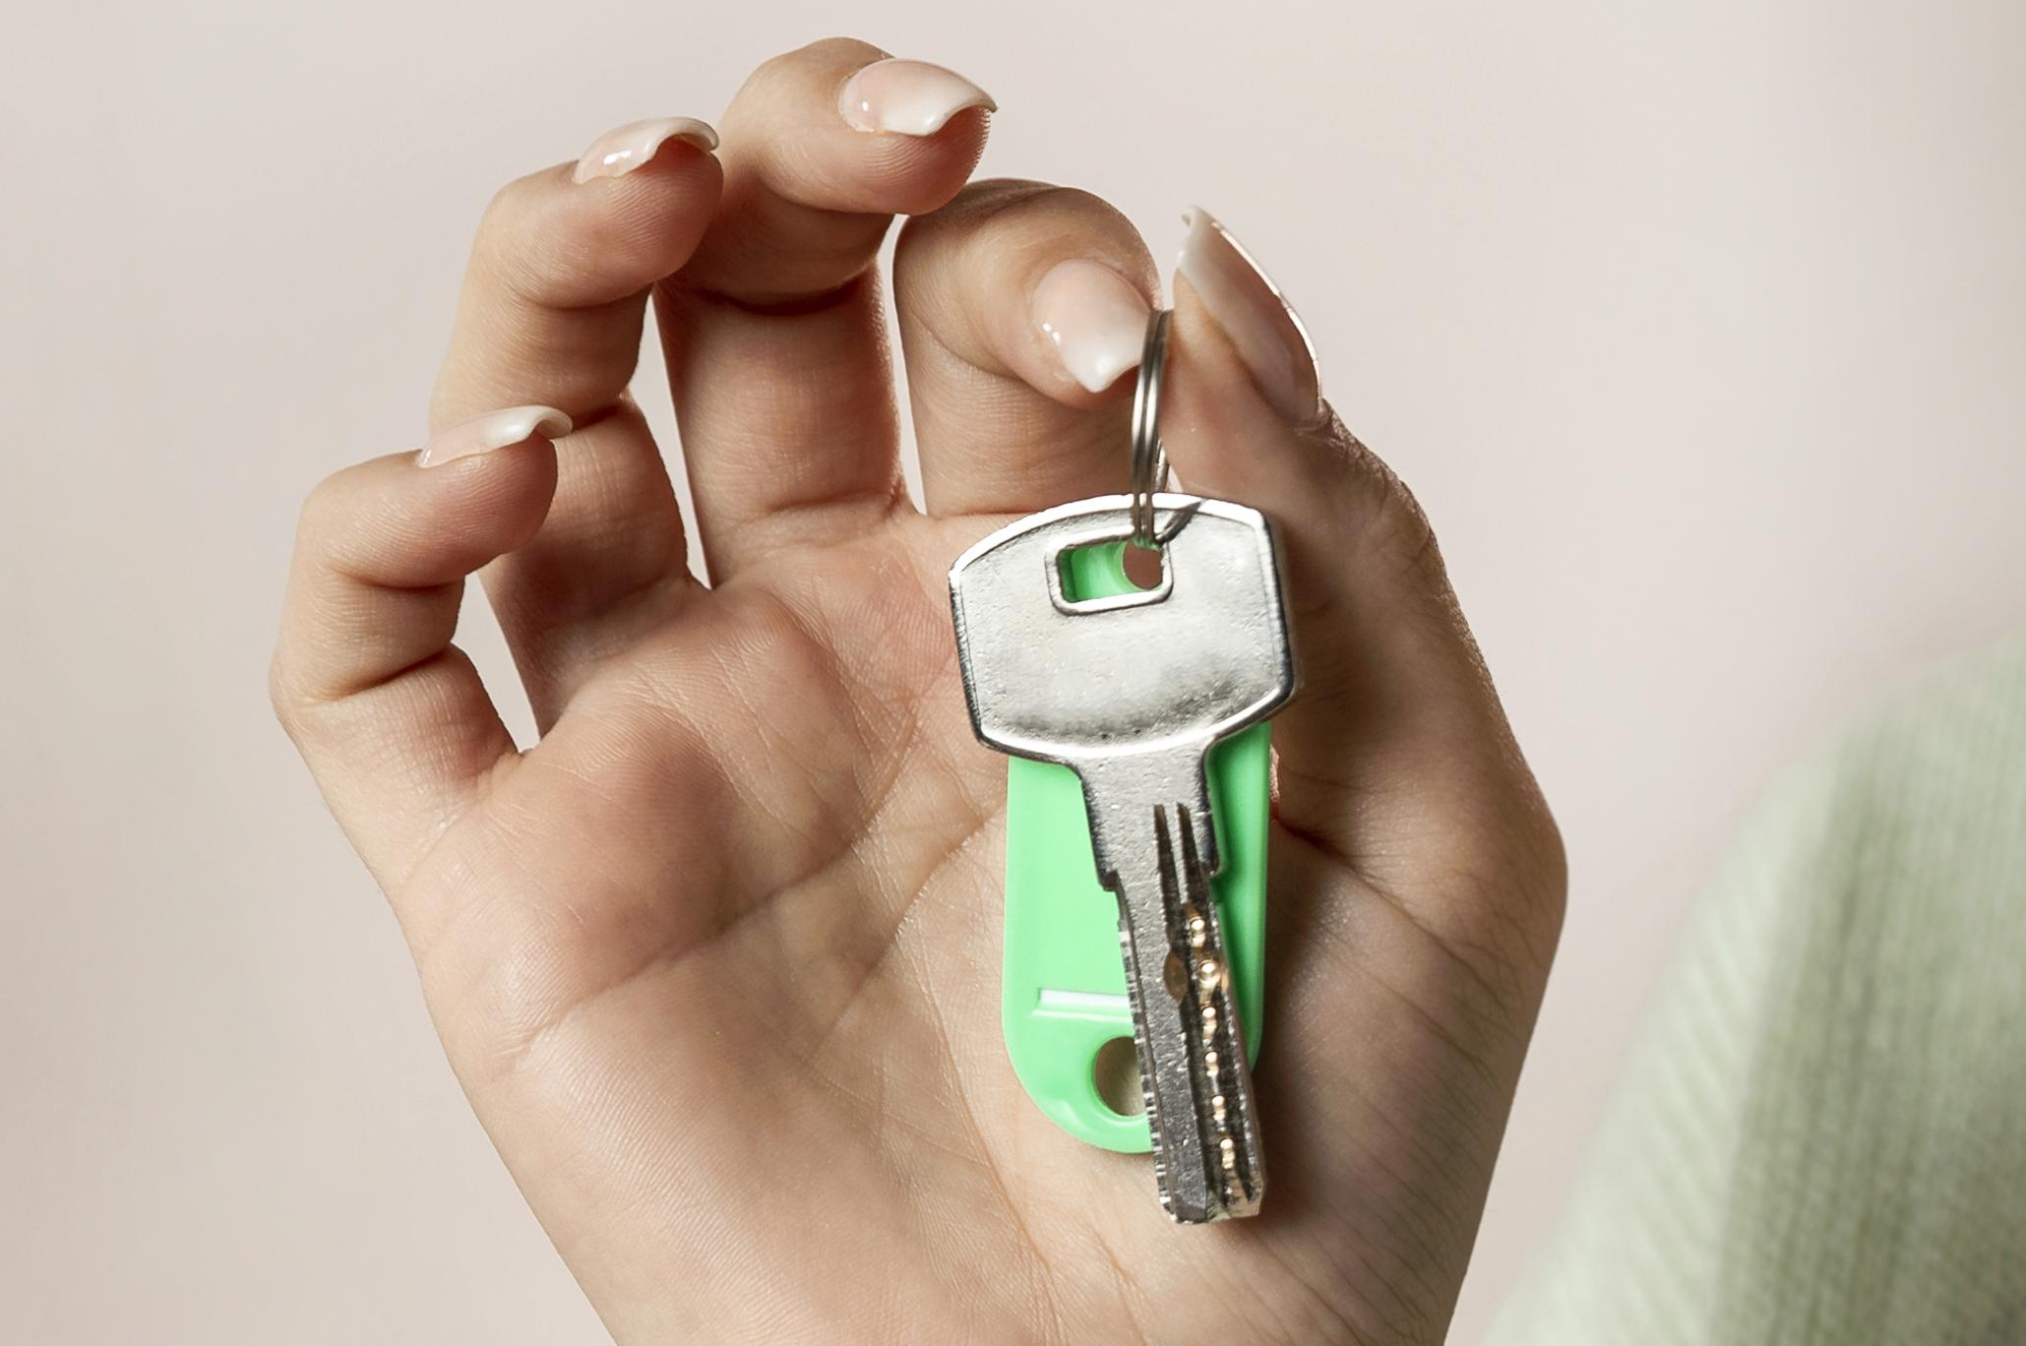
Value Proposition
Patients own & control their medical data
Portable across providers
Cryptographic security + friendly UX
Private blockchain (L1)

Slide 5
Key Features
Role & action management
Encrypted data storage & permissions
Multi-platform: web + mobile
Statistical Data monetization via encrypted tokens

Slide 6




Stakeholders
Patients
Doctors
true data owners
validate records
Insurers
Auditors
validators of network
monitor transactions

Slide 7

Technical Complexity (Access & Security) ADVANTAGE
Digital wallet +
future biometrics
Smart contracts
for permissions
Encrypted data
on L1 blockchain
External storage
for large files

Slide 8
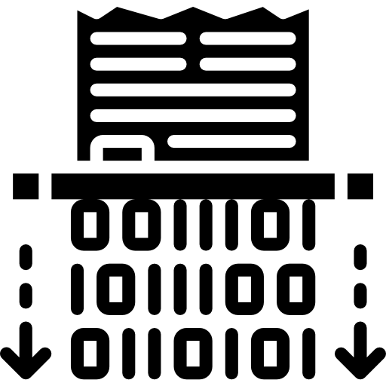



Technical Complexity (Transactions & Privacy)
Encrypted payments (eERC20)
Baby Jubjub + Homomorphic Encryption
Zero Knowledge Proofs
for validation
Identity secured via biometrics

Slide 9
Avalanche Components
Snowman++
low latency
Private permissioned L1 blockchain
Validators: insurers & clinics
EVM compatible (Solidity)

Slide 10
Feasibility & UX
Web & mobile
interfaces
Patient-centric
design
Physicians:
record validation
Auditors: activity
monitoring

Slide 11
Development Roadmap
Stage 1
Stage 2
Smart contracts + IPFS integration
Private Avalanche setup
Stage 3
Stage 4
Audit layer + ZK proofs
Stress testing
multi-user simulation

